Slide 1
My trip to Dublin
Luka Bertok 8a

Slide 2
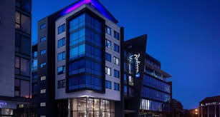
CONGRATULATIONS!
I won 1600€ and I can't believe it! I plan on going on a trip to Ireland with my brother Lovro. I want it to be special and I decide it to go to Dublin because I think that Dublin is very nice place and we could have fun there. We decide it that we are gonna go on a airplane in Zagreb. We will take a bus to Zagreb and after that we will go on a plain to Dublin. On 28.6.2020 we will begin traveling at 8AM with the bus so we have enough time to come to a plane that goes at 11AM. The plane will land in Dublin at 8PM. We are gonna take our savings and we have 800€ each. 1600€ is more than enough for us so we will have enough money for whole trip. We will take enough luggage for the week so we wont have to care about that either. We will stay at Radisson BLU Royal Hotel Dublin hotel for 4 days. 4 days at that hotel costs 700€ and I think that is a fair price. When we come to the hotel we wont go anywhere because we need to get rest

Slide 3
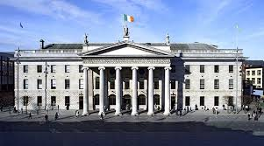
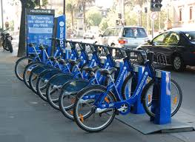
Next day we will go to GPO Witness History Visitor Centre with rent-a-bike.

Slide 4
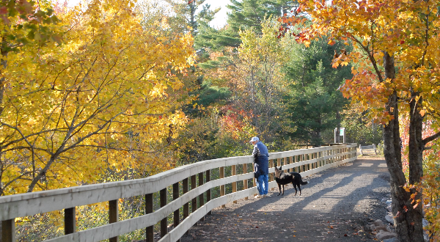
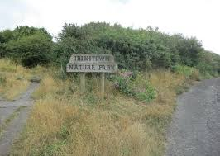
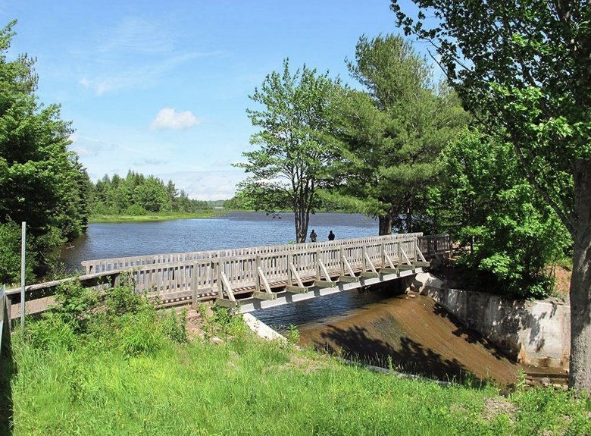
The very next day we will take rent-a-bike again and go to Irishtown Nature Park, Dublin and we will enjoy the nature for a little.

Slide 5
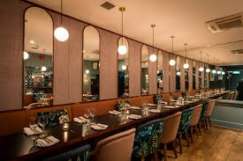
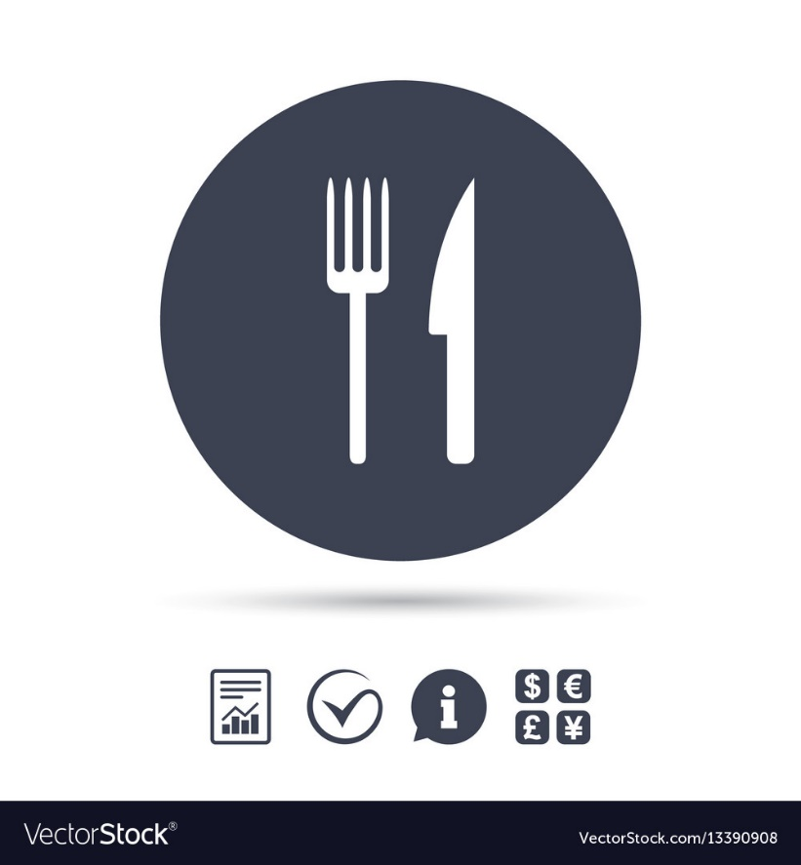
The same day we will go to BANG Restaurant & Bar and we will have some traditional Irish food.

Slide 6
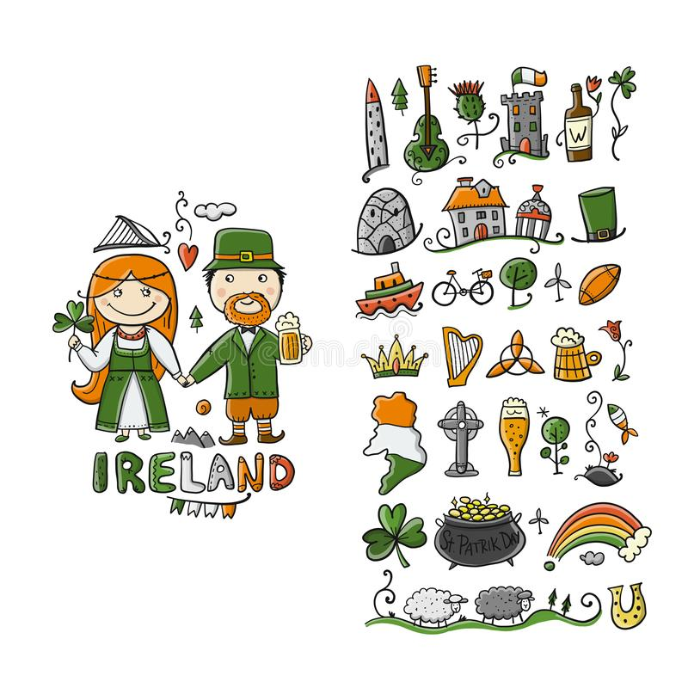
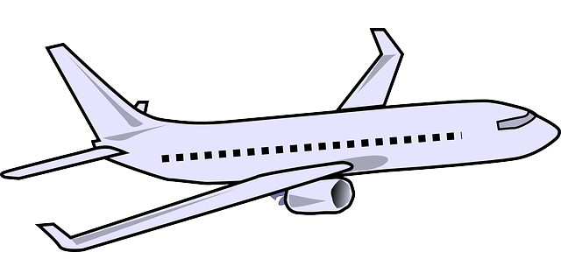
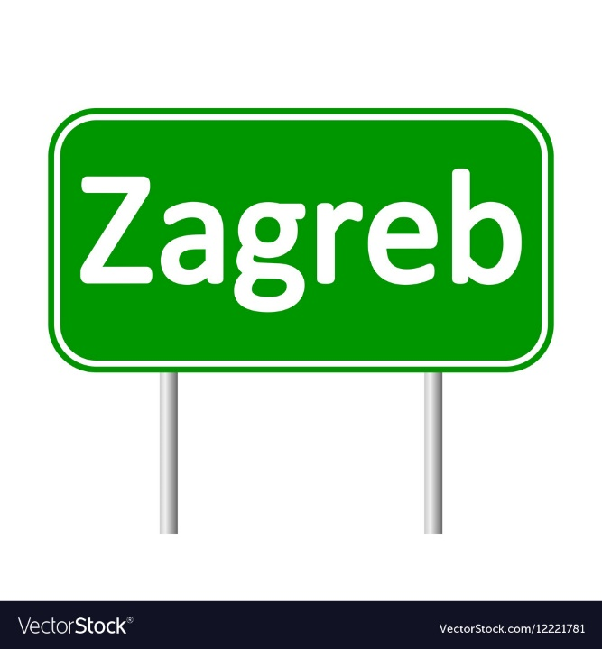
4th day we will go walk around Dublin to see beautiful spots and nature around Dublin. 5th day we will go to airport in Dublin and we will go to Zagreb with plane. When we land we will go with the bus home.

